Slide 1
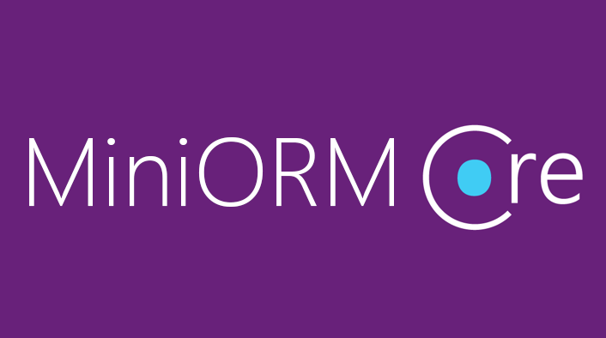
Custom ORM Framework
Overview and Features

Slide 2
MiniORM Core: Overview
Designed after Entity Framework Core
Provides LINQ-based data queries and CRUD operations
Change tracking of in-memory objects
Maps navigation properties
Maps collections
One-to-many, Many-to-many, etc.

Slide 3
MiniORM Core Workflow: Overview
Define data model (database-first)
Entity Classes
DbContext (with DbSets)
Initialize DbContext
Using connection string
Query data using context
Manipulate data (add/remove/update entities)
Context gets persisted into database

Slide 4
MiniORM Components (1)
The DbContext class
Holds the database connection and the DB Sets
Provides LINQ-based data access
Provides change tracking, and an API for CRUD operations
DBSets
Hold entities (objects with their attributes and relations)
Each database table is typically mapped to a single C# class

Slide 5
MiniORM Components (2)
Associations (relationship mappings)
An association is a primary key / foreign key-based relationship between two entity classes
Allows navigation from one entity to another
MiniORM supports one-to-one, one-to-many and many-to-many relationships
var courses = student.Courses.Where(…);

Slide 6
ChangeTracker: Cloning Entities (MiniORM)
In order to check for entity modification, the change tracker clones all entities on initialization
Cloning process
Create new blank instance of entity
Find all properties, which are valid SQL types
Set blank instance's property values to existing entity values

